Slide 1


Slide 2
Central Power Purchasing Agency (Guarantee) Limited
Load Forecast
Section

Slide 3
Introduction
Bilal Ahmad
Consultant CPPA
Electrical Engineering … UET Lahore
MBA … Iqra University Lahore
This Power Market Survey Forecast is 16th Annual Study
Since 1985 when it was developed, continuously removing bugs and adding required modules.

Slide 4
Power Market Survey (PMS )
Model Over View

Slide 5
Model Used For Medium Term Forecast
POWER MARKET SURVEY (PMS) Model

Slide 6
Authenticity of Forecast
Comparison Of PMS Forecast Results With Historical Peak Data proves The accuracy Of PMS Forecast
Comparison of Previous report of 2012-13 with actual values
Comparison of recent forecast of 2015-16 with actual values
Comparison of Other forecast with actual values

Slide 7
Comparison of PMS based forecast for NTDC System

Slide 8
Authenticity Of PMS Forecast
Comparison of PMS Peak Demand and actual Peak Demand
Years | Historical Peak (MW) | PMS Peak | Difference (%)
1999-00 | 9289 | 9311 | 0.2
2000-01 | 9718 | 9736 | 0.2
2001-02 | 10922 | 10243 | -6.2
2002-03 | 10484 | 10799 | 3.0
2003-04 | 11078 | 11398 | 2.8
2004-05 | 12035 | 12087 | 0.4
2005-06 | 13212 | 12916 | -2.2
2006-07 | 15138 | 15213 | 0.5
2007-08 | 16838 | 16480 | -2.1
2008-09 | 17252 | 17867 | 3.6
2009-10 | 17847 | 19451 | 8.9
2010-11 | 18270 | 19136 | 4.7
2011-12 | 19488 | 19400 | 0.5

Slide 9
Comparison of PMS Peak Demand and actual Peak Demand (Continued)
Years | Historical Peak (MW) | PMS Peak | Difference (%)
2012-13 | 18227 | 18697 | 2.6%
2013-14 | 19966 | 19641 | -1.6%
2014-15 | 21031 | 20583 | -2.1%
2015-16 | 22559 | 21575 | -4.4%
2016-17 | 25717 | 24155 | -6.1%
2017-18 | 26741 | 26633 | -0.3%
2018-19 | 25627 | 25579 | -0.19%
From Base Year

Slide 10
Comparison of PMS Peak Demand and actual Peak Demand (Continued)
Years | Historical | PMS 2012-13 |  | PMS 2015-16 |  | PMS 2016-17
 | Peak (MW) | Peak | Difference (%) | Peak | Difference (%) | Peak | Difference (%)
2012-13* | 18227 | 18697 | 2.6%
2013-14* | 19966 | 19641 | -1.6%
2014-15* | 21031 | 20583 | -2.1%
2015-16* | 22559 | 21575 | -4.4%
2016-17* | 25717 | 22662 | -11.9% | 24155 | -6.1%
2017-18* | 26741 | 23764 | -11.1% | 25241 | -5.6% | 26633 | -0.3%
2018-19* | 25627 | 24887 | -2.9% | 25709 | 0.32% | 27034 | 5.5%

Slide 11
Authenticity Of PMS Forecast

Slide 12
Actual Peak demand

Slide 13
Comparison of Forecast Report base year 1993-94 with Actual Peak demand

Slide 14
Comparison of Forecast Reports base year 1993-94, 1999-2000 with Actual Peak demand

Slide 15
Comparison of Forecast Reports base year 1993-94, 1999-00, 2010-11 with Actual Peak demand

Slide 16
Comparison of Forecast Reports base year 1993-94, 1999-00, 2010-11, 2011-12 with Actual Peak demand

Slide 17
Comparison of Forecast Reports base year 1993-94, 1999-00, 2010-11, 2011-12, 2012-13 with Actual Peak demand

Slide 18
Comparison of Forecast Reports base year 1993-94, 1999-00, 2010-11, 2011-12, 2012-13 , 2013-14 with Actual Peak demand

Slide 19
Comparison of Forecast Reports base year 1993-94, 1999-00, 2010-11, 2011-12, 2012-13 , 2013-14, 2015-16 with Actual Peak demand

Slide 20
Comparison of Forecast Reports base year 1993-94, 1999-00, 2010-11, 2011-12, 2012-13 , 2013-14, 2015-16 and 2016-17 with Actual Peak demand

Slide 21
Comparison of Forecast Reports base year 1993-94, 1999-00, 2010-11, 2011-12, 2012-13 , 2013-14, 2015-16, 2016-17 and 2017-18 with Actual Peak demand

Slide 22
COMPARISON OF PMS FORECAST REPORT 2012-13 WITH ACTUAL FIGURES

Slide 23
COMPARISON OF PMS FORECAST REPORT 2012-13 WITH ACTUAL FIGURES

Slide 24
COMPARISON OF PMS FORECAST REPORT 2012-13 WITH ACTUAL FIGURES
5.5 %
7.2 %
-2.4 %
1.7 %
-14.5%
15.5 %
21.3 %
-1.4 %
34.5%
23.4 %

Slide 25
COMPARISON OF PMS FORECAST REPORT 2012-13 WITH ACTUAL FIGURES
2.8%
5.5%
-2.8%
11.5%
1.9%
-14.9%
12.3%
29.5%
-3.7%
28.4%

Slide 26
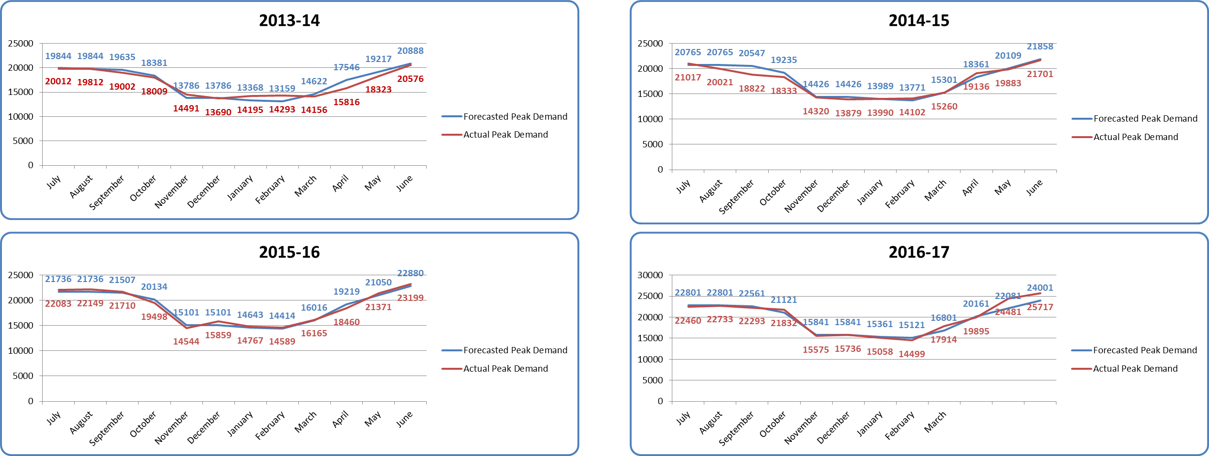
COMPARISON OF PMS FORECAST REPORT 2012-13 WITH ACTUAL FIGURES (Monthly)
Computed Monthly Peak Demand ( MW)

Slide 27
COMPARISON OF PMS FORECAST REPORT 2012-13 WITH ACTUAL FIGURES (Yearly)

Slide 28
COMPARISON OF PMS FORECAST REPORT 2015-16 WITH ACTUAL FIGURES

Slide 29
COMPARISON OF PMS FORECAST REPORT 2015-16 WITH ACTUAL FIGURES

Slide 30
COMPARISON OF PMS FORECAST REPORT 2016-17 WITH ACTUAL FIGURES

Slide 31
COMPARISON OF PMS FORECAST REPORT 2016-17 WITH ACTUAL FIGURES

Slide 32
COMPARISON OF PMS FORECAST REPORT 2017-18 WITH ACTUAL FIGURES

Slide 33
COMPARISON OF PMS FORECAST REPORT 2015-16 WITH ACTUAL FIGURES

Slide 34
COMPARISON OF PMS FORECAST REPORT 2015-16 WITH ACTUAL FIGURES

Slide 35
COMPARISON OF PMS FORECAST REPORT 2015-16 WITH ACTUAL FIGURES
3.4%
-2.7%
-0.9%
-2.9%
-2.5%
-2.7%
-0.8%
-2.9%
0.2 %
-8.74%

Slide 36
COMPARISON OF PMS FORECAST REPORT 2015-16 WITH ACTUAL FIGURES

Slide 37
COMPARISON OF PMS FORECAST REPORT 2015-16 WITH ACTUAL FIGURES

Slide 38
COMPARISON OF PMS FORECAST REPORT 2015-16 WITH ACTUAL FIGURES

Slide 39
COMPARISON OF PMS FORECAST REPORT 2015-16 WITH ACTUAL FIGURES

Slide 40
COMPARISON OF PMS FORECAST REPORT 2015-16 WITH ACTUAL FIGURES
-3.1%
-2.1%
5.9%
-5.8%
0.8%
2.3%
41.7%
-0.5%
16.9%
-0.3%

Slide 41
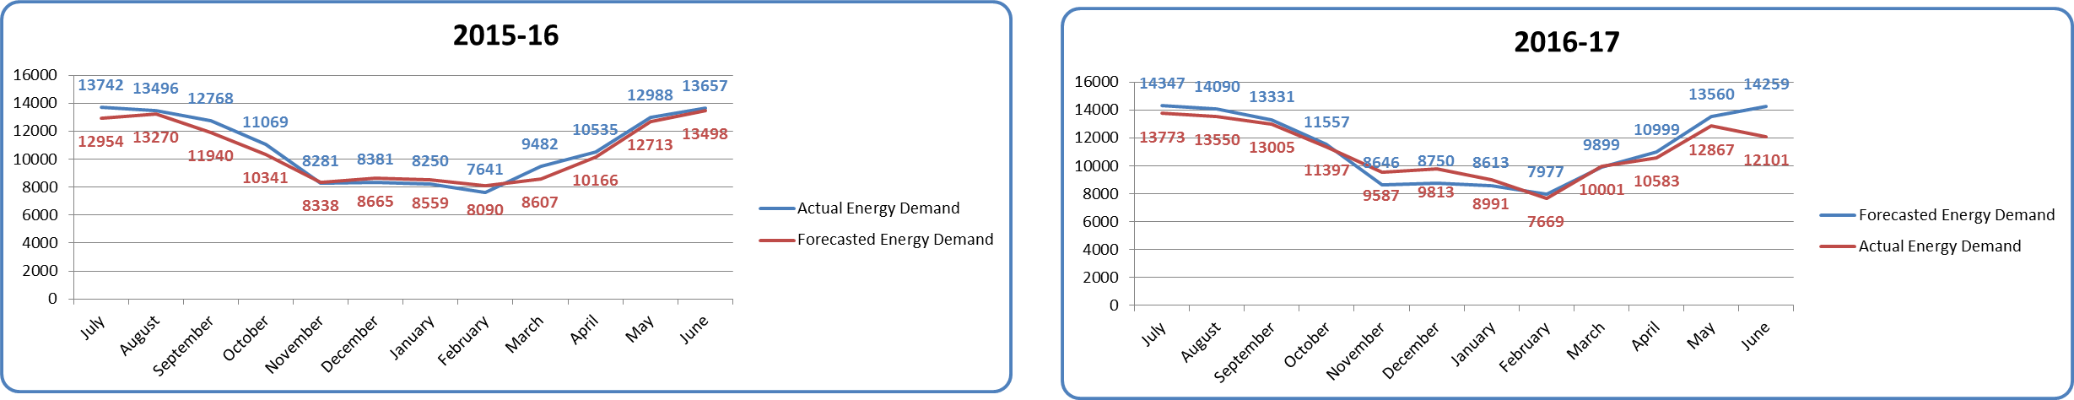
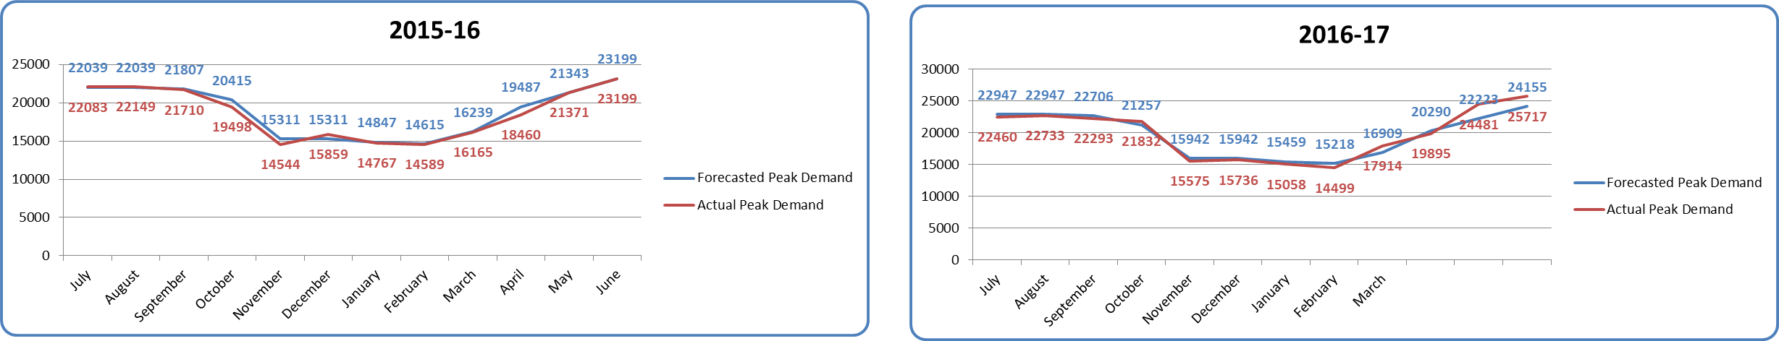
COMPARISON OF PMS FORECAST REPORT 2015-16 WITH ACTUAL FIGURES FOR 2016-17
Computed Monthly Energy Generation (GWH)
Computed Monthly Peak Demand (MW)

Slide 42
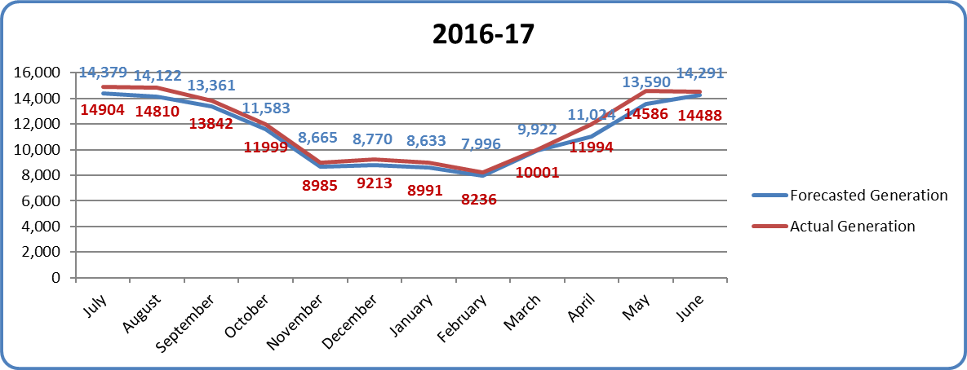
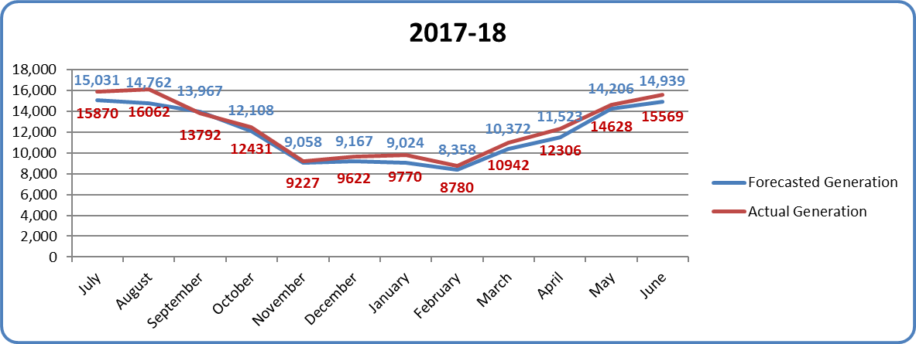
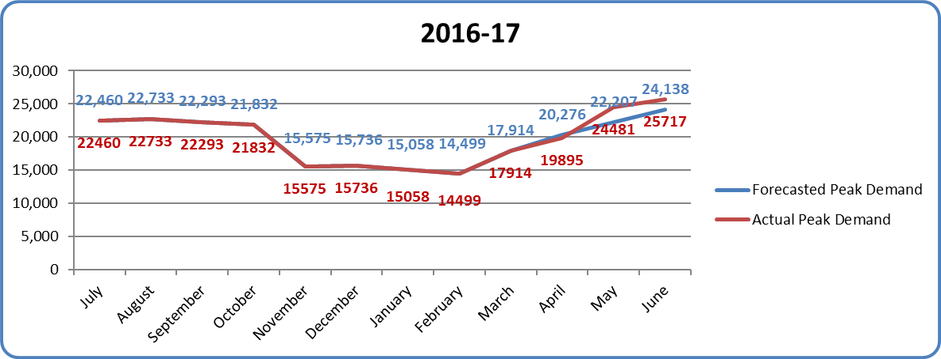
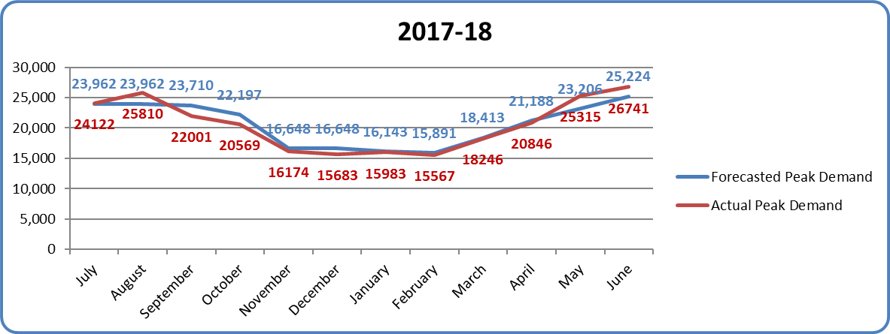
COMPARISON OF PMS FORECAST REPORT 2015-16 WITH ACTUAL FIGURES FOR 2016-17 and 2017-18
Computed Monthly Energy Generation (GWH)
Computed Monthly Peak Demand (MW)

Slide 43
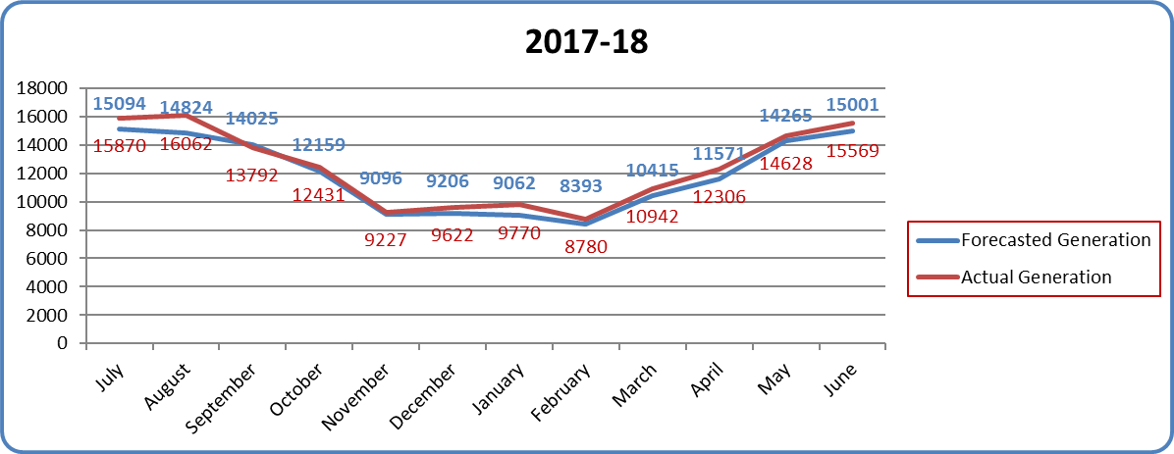
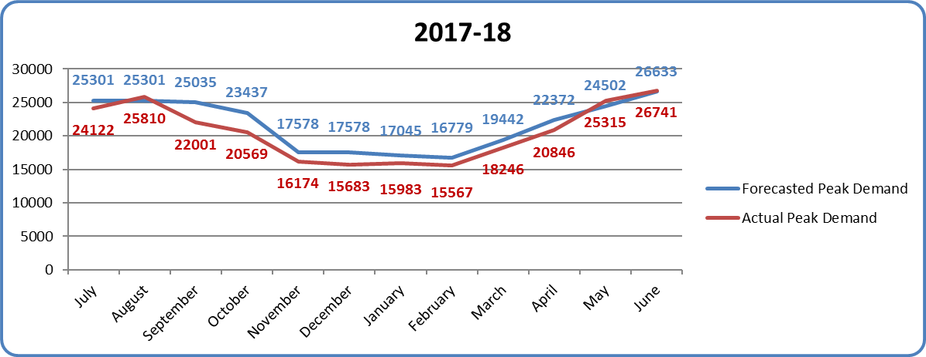
COMPARISON OF PMS FORECAST REPORT 2016-17 WITH ACTUAL FIGURES FOR 2017-18
Computed Monthly Energy Generation (GWH)
Computed Monthly Peak Demand (MW)

Slide 44
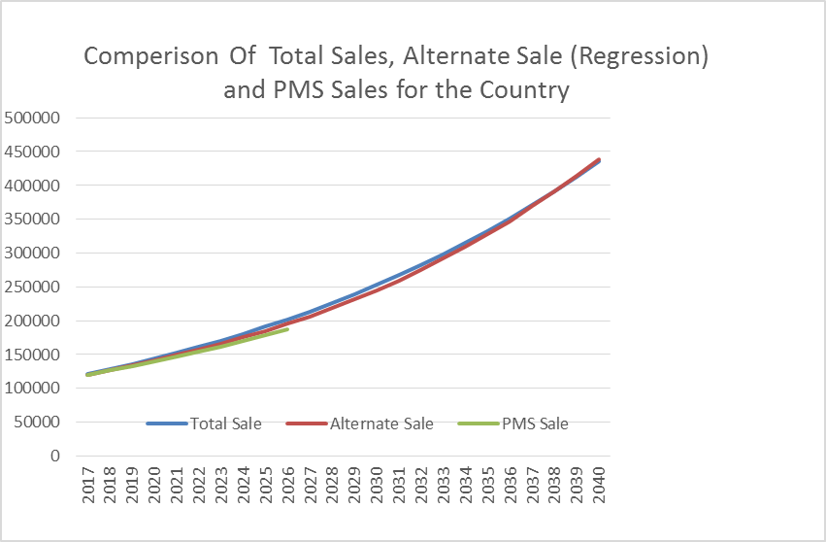
Comparison Of Total Sales, Alternate Sale (Regression) and PMS Sales for the Country

Slide 45
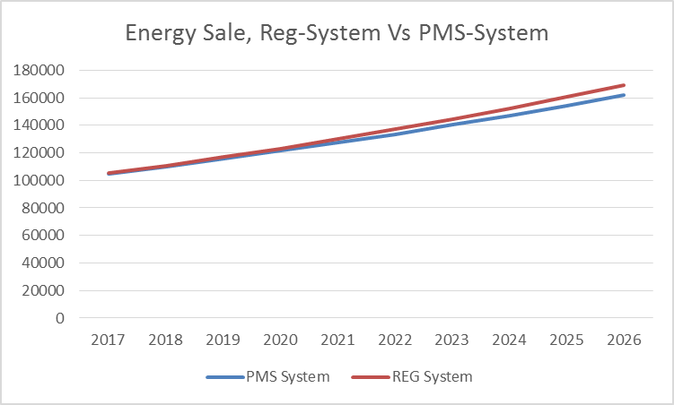
Energy Sale, Reg_System Vs PMS- System

Slide 46
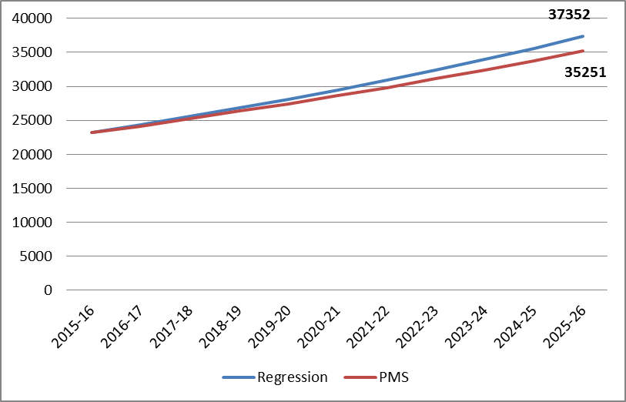
Peak Demand Forecast Reg_System Vs PMS- System (2015-16)

Slide 47
COMPARISON OF PMS FORECAST REPORT 2016-17 WITH ACTUAL FIGURES

Slide 48
COMPARISON OF PMS FORECAST REPORT 2016-17 WITH ACTUAL FIGURES

Slide 49
COMPARISON OF PMS FORECAST REPORT 2016-17 WITH ACTUAL FIGURES

Slide 50
COMPARISON OF PMS FORECAST REPORT 2016-17 WITH ACTUAL FIGURES
0.53%
-0.67%
-10.84%
1.74%
-2.53%
0%
-4.61%
-5.35%
-10.03%
-4.55%

Slide 51
COMPARISON OF PMS FORECAST REPORT 2017-18 WITH ACTUAL FIGURES

Slide 52
COMPARISON OF PMS FORECAST REPORT 2017-18 WITH ACTUAL FIGURES
2.3 %
5.4 %
0.4 %
2.8 %
3.1 %
2.6 %
7.5 %
6.5 %
9 %
10.7 %

Slide 53
COMPARISON OF PMS FORECAST REPORT 2017-18 WITH ACTUAL FIGURES
0.8 %
1 %
0.8 %
-3.3 %
7.7 %

Slide 54
COMPARISON OF PMS FORECAST REPORT 2017-18 WITH ACTUAL FIGURES

Slide 55
COMPARISON OF PMS FORECAST REPORT 2017-18 WITH ACTUAL FIGURES
-0.19

Slide 56
COMPARISON OF PMS FORECAST REPORT 2017-18 WITH ACTUAL FIGURES

Slide 57
COMPARISON OF PMS FORECAST REPORT 2017-18 WITH ACTUAL FIGURES

Slide 58
DISCOs forecasting performance

Slide 59
DISCOs forecasting performance

